Slide 1
Chapter 3
E-commerce Infrastructure: The Internet, Web, and Mobile Platform
Copyright © 2014 Pearson Education, Inc. Publishing as Prentice Hall

Slide 2
The Internet: Technology Background
Internet
  Interconnected network of thousands of networks and millions of computers
  Links businesses, educational institutions, government agencies, and individuals
World Wide Web (Web)
  One of the Internet’s most popular services
  Provides access to billions, possibly trillions, of Web pages
Copyright © 2014 Pearson Education, Inc. Publishing as Prentice Hall
Slide 3-<number>

Slide 3
Evolution of the Internet 1961–Present
Innovation Phase, 1964–1974
  Creation of fundamental building blocks
    Packet switching, TCP/IP, Client-server computing
Institutionalization Phase, 1975–1995
  Large institutions (NSF, DoD) provide funding and legitimization creating ARPARNET
Commercialization Phase, 1995–present
  Private corporations take over, expand Internet backbone and local service
Copyright © 2014 Pearson Education, Inc. Publishing as Prentice Hall
Slide 3-<number>

Slide 4
The Internet: Key Technology Concepts
Internet defined as network that:
  Uses IP addressing
  Supports TCP/IP
  Provides services to users, in manner similar to telephone system
Three important concepts:
  Packet switching
  TCP/IP communications protocol
  Client/server computing
Copyright © 2014 Pearson Education, Inc. Publishing as Prentice Hall
Slide 3-<number>

Slide 5
Packet Switching
Slices digital messages into packets
Sends packets along different communication paths as they become available
Reassembles packets once they arrive at destination
Uses routers
  Special purpose computers that interconnect the computer networks that make up the Internet and route packets
  Routing algorithms ensure packets take the best available path toward their destination
Less expensive, wasteful than circuit-switching
Copyright © 2014 Pearson Education, Inc. Publishing as Prentice Hall
Slide 3-<number>

Slide 6
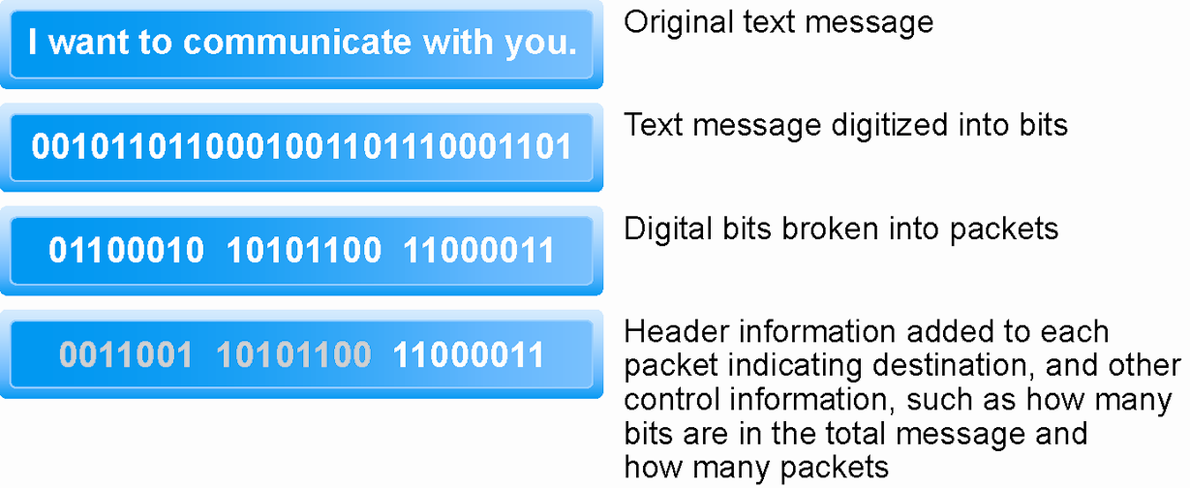
Packet Switching
Figure 3.3, Page 117
Copyright © 2014 Pearson Education, Inc. Publishing as Prentice Hall
Slide 3-<number>

Slide 7
TCP/IP
Transmission Control Protocol (TCP)
  Establishes connections among sending and receiving Web computers
  Handles assembly of packets at point of transmission, and reassembly at receiving end
Internet Protocol (IP)
  Provides the Internet’s addressing scheme
Four TCP/IP layers
  Network interface or link layer responsible for sending and receiving packets
  Internet layer responsible for addressing and routing
  Transport layer handles host-to-host communication
  Application layer provides process-to-process application data exchange (apps: HTTP, FTP, SMTP).
Copyright © 2014 Pearson Education, Inc. Publishing as Prentice Hall
Slide 3-<number>

Slide 8
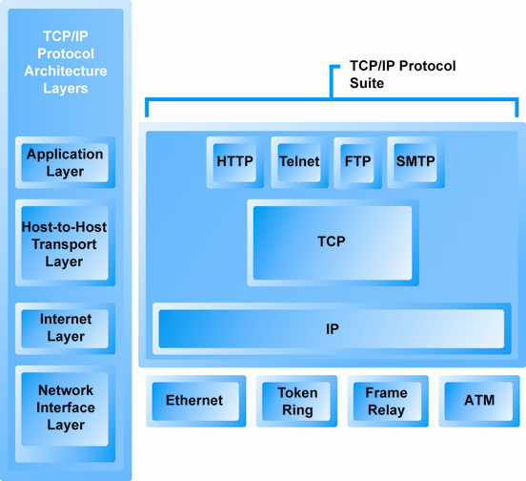
The TCP/IP Architecture and Protocol Suite
Figure 3.4, Page 119
Copyright © 2014 Pearson Education, Inc. Publishing as Prentice Hall
Slide 3-<number>

Slide 9
Internet (IP) Addresses
IPv4
  32-bit number
  Four sets of numbers marked off by periods: 201.61.186.227
    Class C address: Network identified by first three sets, computer identified by last set
IPv6
  128-bit addresses, able to handle up to 1 quadrillion addresses (IPv4 can handle only 4 billion)
Copyright © 2014 Pearson Education, Inc. Publishing as Prentice Hall
Slide 3-<number>

Slide 10
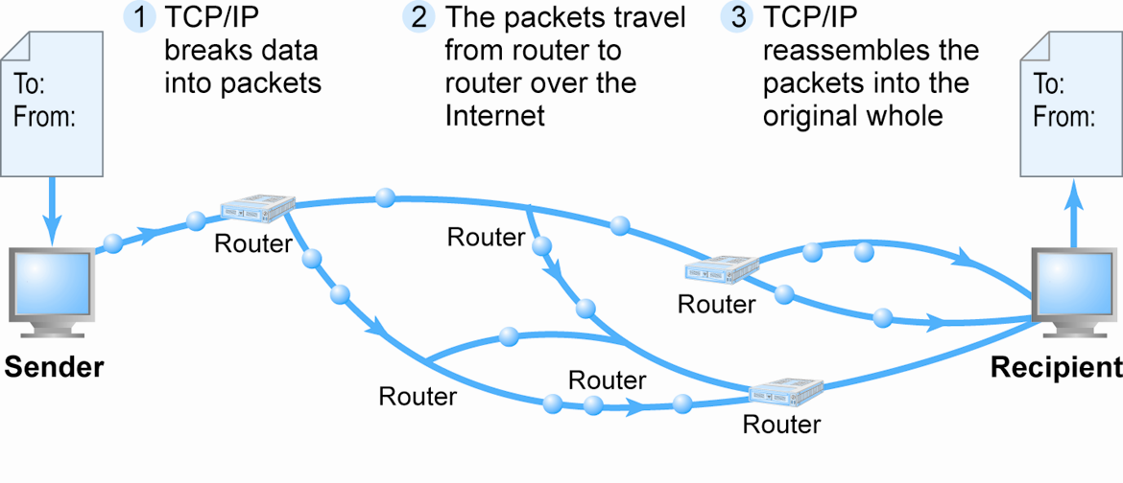
Routing Internet Messages: TCP/IP and Packet Switching
Figure 3.5, Page 120
Copyright © 2014 Pearson Education, Inc. Publishing as Prentice Hall
Slide 3-<number>

Slide 11
Domain Names, DNS, and URLs
Domain name (.edu, .com, .org etc) (See figure)
  IP address expressed in natural language
Domain name system (DNS)
  Allows numeric IP addresses to be expressed in natural language
Uniform resource locator (URL)
  Address used by Web browser to identify location of content on the Web
  For example: http://www.azimuth-interactive.com/flash_test
Copyright © 2014 Pearson Education, Inc. Publishing as Prentice Hall
Slide 3-<number>

Slide 12
Client/Server Computing
Powerful personal computers (clients) connected in network with one or more servers
Servers perform common functions for the clients
  Storing files
  Software applications
  Access to printers, and other peripherals
Copyright © 2014 Pearson Education, Inc. Publishing as Prentice Hall
Slide 3-<number>

Slide 13
The New Client:
The Mobile Platform
In a few years, primary Internet access will be through:
  Tablets
    Supplementing PCs for mobile situations
  Smartphones
    Disruptive technology:
      Shift in processors, operating systems
    33% of all cell phones
Copyright © 2014 Pearson Education, Inc. Publishing as Prentice Hall
Slide 3-<number>

Slide 14
Cloud Computing
Firms and individuals obtain computing power and software over Internet
  Example: Google Apps
Fastest growing form of computing
Radically reduces costs of:
  Building and operating Web sites
  Infrastructure, IT support
  Hardware, software
Copyright © 2014 Pearson Education, Inc. Publishing as Prentice Hall
Slide 3-<number>

Slide 15
Other Internet Protocols and
Utility Programs
Internet protocols
  HTTP
  E-mail: SMTP, POP3, IMAP alternative to POP
  FTP, Telnet, SSL/TLS newer alternative to SSL
Utility programs
  Ping
  Tracert route/path tracing utility
Copyright © 2014 Pearson Education, Inc. Publishing as Prentice Hall
Slide 3-<number>

Slide 16
The Internet Today
Internet growth has boomed without disruption because of:
  Client/server computing model
  Hourglass, layered architecture (next slide)
    Network Technology Substrate
    Transport Services and Representation Standards
    Middleware Services
    Applications
Copyright © 2014 Pearson Education, Inc. Publishing as Prentice Hall
Slide 3-<number>

Slide 17
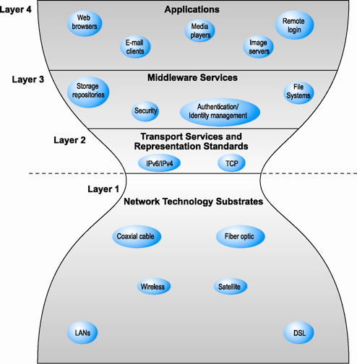
The Hourglass Model of the Internet
Figure 3.11, Page 128
Copyright © 2014 Pearson Education, Inc. Publishing as Prentice Hall
Slide 3-<number>

Slide 18
Internet Network Architecture
Backbone
  High-bandwidth fiber-optic cable networks
  Private networks owned by a variety of NSPs
  Bandwidth: 155 Mbps–2.5 Gbps
  Built-in redundancy
IXPs (Internet Exchange Points see figure)
  Hubs where backbones intersect with regional and local networks, and backbone owners connect with one another
CANs (campus area networks)
  LANs operating within a single organization that leases Internet access directly from regional or national carrier
Copyright © 2014 Pearson Education, Inc. Publishing as Prentice Hall
Slide 3-<number>

Slide 19
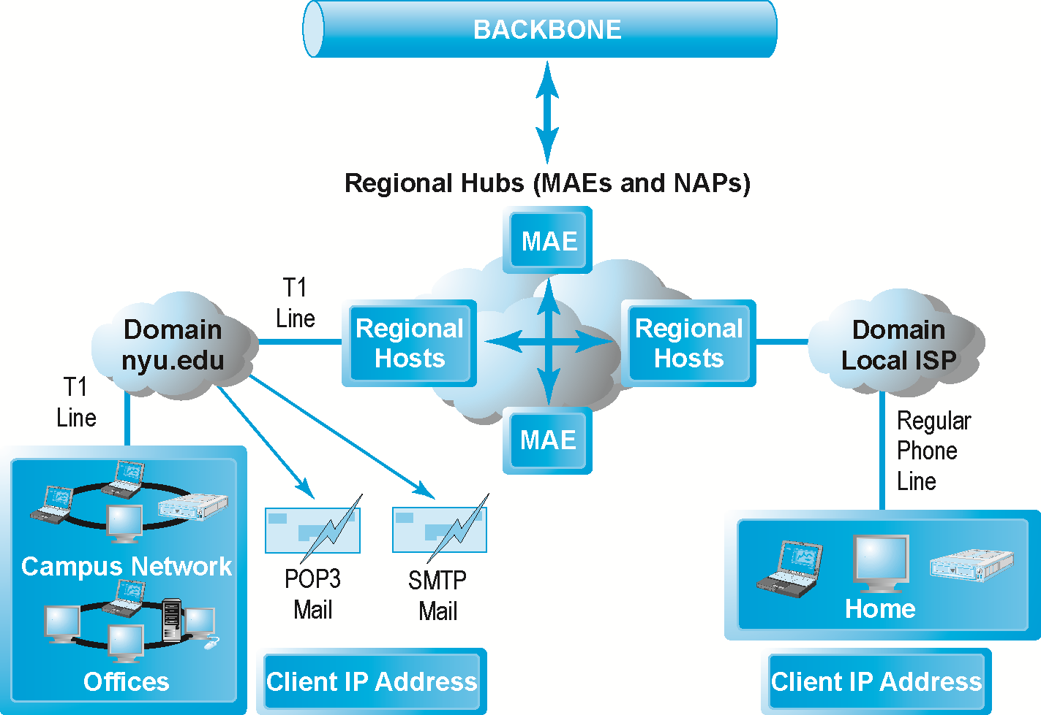
Internet Network Architecture
Figure 3.12, Page 129
Copyright © 2014 Pearson Education, Inc. Publishing as Prentice Hall
Slide 3-<number>

Slide 20
Internet Service Providers (ISPs)
Provide lowest level of service to individuals, small businesses, some institutions
Types of service
  Narrowband (dial-up)
  Broadband
    Digital Subscriber Line (DSL)
    Cable modem
    T1 and T3
    Satellite
Copyright © 2014 Pearson Education, Inc. Publishing as Prentice Hall
Slide 3-<number>

Slide 21
Intranets
Intranet
  TCP/IP network located within a single organization for communications and processing
  Used by private and government organizations for internal networks
  All Internet applications can be used in private intranets
Copyright © 2014 Pearson Education, Inc. Publishing as Prentice Hall
Slide 3-<number>

Slide 22
Who Governs the Internet?
Organizations that influence the Internet and monitor its operations include:
  Internet Corporation for Assigned Names and Numbers (ICANN)
  Internet Assigned Numbers Authority (IANA)
  Internet Engineering Task Force (IETF)
  Internet Research Task Force (IRTF)
  Internet Engineering Steering Group (IESG)
  Internet Architecture Board (IAB)
  Internet Society (ISOC)
  Internet Governance Forum (IGF)
  World Wide Web Consortium (W3C)
  Internet Network Operators Groups (NOGs)
Copyright © 2014 Pearson Education, Inc. Publishing as Prentice Hall
Slide 3-<number>

Slide 23
Limitations of the Current Internet
Bandwidth limitations
  Slow peak-hour service
Quality of service limitations
  Latency - uneven flow of info packets
Network architecture limitations
  Identical requests are processed individually
Wired Internet
  Copper and expensive fiber-optic cables
Copyright © 2014 Pearson Education, Inc. Publishing as Prentice Hall
Slide 3-<number>

Slide 24
The Internet2 Project
Consortium of 350+ institutions collaborating to facilitate revolutionary Internet technologies
Primary goals:
  Create leading-edge very-high speed 100 gps network for national research community
  Enable revolutionary Internet applications
  Distributed and collaborative computing environments for sciences, health, arts, and humanities initiatives
Copyright © 2014 Pearson Education, Inc. Publishing as Prentice Hall
Slide 3-<number>

Slide 25
The First Mile and the Last Mile
GENI Initiative
  Proposed by NSF to develop new core functionality for Internet with gigabit/terabit bandwidth to households in 20 yrs
Most significant private initiatives
  Fiber optic trunk-line bandwidth
    First mile
  Wireless Internet services
    Last mile (eg. FIOS 50 mps up and 10 down)
Copyright © 2014 Pearson Education, Inc. Publishing as Prentice Hall
Slide 3-<number>

Slide 26
Fiber Optics and the Bandwidth
Explosion in the First Mile
“First mile”: Backbone Internet services that carry bulk traffic over long distances
Fiber-optic cable: hundreds of glass strands that use light to transmit data
  Faster speeds and greater bandwidth
  Thinner, lighter cables
  Less interference
  Better data security
Substantial investments in fiber optic by telecommunications firms in last decade
  Enable integrated phone, broadband access, video services
Copyright © 2014 Pearson Education, Inc. Publishing as Prentice Hall
Slide 3-<number>

Slide 27
The Last Mile: Mobile Internet Access
“Last mile”: From Internet backbone to user’s computer, smartphone, and so on
Two different basic types of wireless Internet access:
  Telephone-based (mobile phones, smartphones)
  Wireless local area network (WLAN)-based
Copyright © 2014 Pearson Education, Inc. Publishing as Prentice Hall
Slide 3-<number>

Slide 28
Wireless Internet Access
Network Technologies
Wi-Fi
  High-speed, fixed broadband wireless LAN (WLAN)
  Wireless access point (“hot spots”)
  Limited range but inexpensive
  For-profit Wi-Fi networks: Boingo, AT&T Wi-Fi Services
WiMax
  High-speed, medium range broadband wireless metropolitan area network
Bluetooth
  Personal connectivity between devices and to Internet
  Low-speed, short range connection
Copyright © 2014 Pearson Education, Inc. Publishing as Prentice Hall
Slide 3-<number>

Slide 29
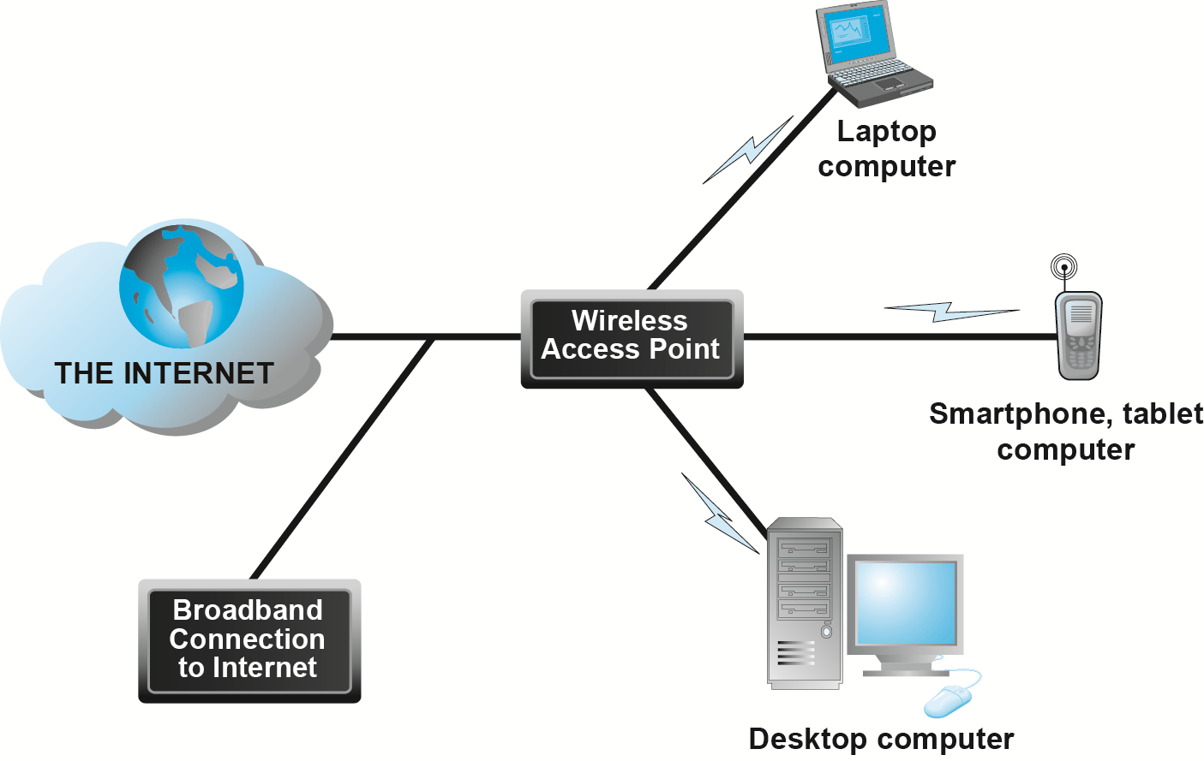
Wi-Fi Networks
Figure 3.15, Page 145
Copyright © 2014 Pearson Education, Inc. Publishing as Prentice Hall
Slide 3-<number>

Slide 30
The Future Internet
Latency solutions
  diffserv (differentiated quality of service)
Guaranteed service levels and lower error rates
  Ability to purchase the right to move data through network at guaranteed speed in return for higher fee
Declining costs
The Internet of Things (IoT)
  Objects connected via sensors/RFID to the Internet
  Spearheaded by EU and China
Copyright © 2014 Pearson Education, Inc. Publishing as Prentice Hall
Slide 3-<number>

Slide 31
The Web
1989–1991: Web invented
  Tim Berners-Lee at CERN
  HTML, HTTP, Web server, Web browser
1993: Mosaic Web browser w/GUI
  Andreessen and others at NCSA
  Runs on Windows, Macintosh, or Unix
1994: Netscape Navigator, first commercial Web browser
  Andreessen, Jim Clark
1995: Microsoft Internet Explorer
Copyright © 2014 Pearson Education, Inc. Publishing as Prentice Hall
Slide 3-<number>

Slide 32
Hypertext
Text formatted with embedded links
  Links connect documents to one another, and to other objects such as sound, video, or animation files
Uses Hypertext Transfer Protocol (HTTP) and URLs to locate resources on the Web
  Example URL: http://megacorp.com/content/features/082602.html
Copyright © 2014 Pearson Education, Inc. Publishing as Prentice Hall
Slide 3-<number>

Slide 33
Markup Languages
Hypertext Markup Language (HTML)
  Fixed set of pre-defined markup “tags” used to format text
  Controls look and feel of Web pages
  HTML5 the newest version
eXtensible Markup Language (XML)
  Designed to describe data and information
  Tags used are defined by user
Copyright © 2014 Pearson Education, Inc. Publishing as Prentice Hall
Slide 3-<number>

Slide 34
Web Servers and Web Clients
Web server software
  Enables a computer to deliver Web pages to clients on a network that request this service by sending an HTTP request
  Apache, Microsoft IIS
  Basic capabilities: Security services, FTP, search engine, data capture
Web server
  May refer to either Web server software or physical server
  Specialized servers: Database servers, ad servers, and so on
Web client
  Any computing device attached to the Internet that is capable of making HTTP requests and displaying HTML pages
Copyright © 2014 Pearson Education, Inc. Publishing as Prentice Hall
Slide 3-<number>

Slide 35
Web Browsers
Primary purpose to display Web pages
Internet Explorer—54% of market
Mozilla Firefox—20%
  Open source
Other browsers
  Google Chrome—19%
  Apple’s Safari—5%
Copyright © 2014 Pearson Education, Inc. Publishing as Prentice Hall
Slide 3-<number>

Slide 36
The Internet and Web: Features
Features on which the foundations of
e-commerce are built:
  E-mail
  Instant messaging
  Search engines
  Online forums and chat
  Streaming media
  Cookies
Copyright © 2014 Pearson Education, Inc. Publishing as Prentice Hall
Slide 3-<number>

Slide 37
E-mail
Most used application of the Internet
Uses series of protocols for transferring messages with text and attachments from one Internet user to another
Instant Messaging
Displays words typed on a computer almost instantly, and recipients can respond immediately in the same way
Copyright © 2014 Pearson Education, Inc. Publishing as Prentice Hall
Slide 3-<number>

Slide 38
Search Engines
Identify Web pages that match queries based on one or more techniques
  Keyword indexes, page ranking
Also serve as:
  Shopping tools
  Advertising vehicles (search engine marketing)
  Tool within e-commerce sites
Outside of e-mail, most commonly used Internet activity
Copyright © 2014 Pearson Education, Inc. Publishing as Prentice Hall
Slide 3-<number>

Slide 39
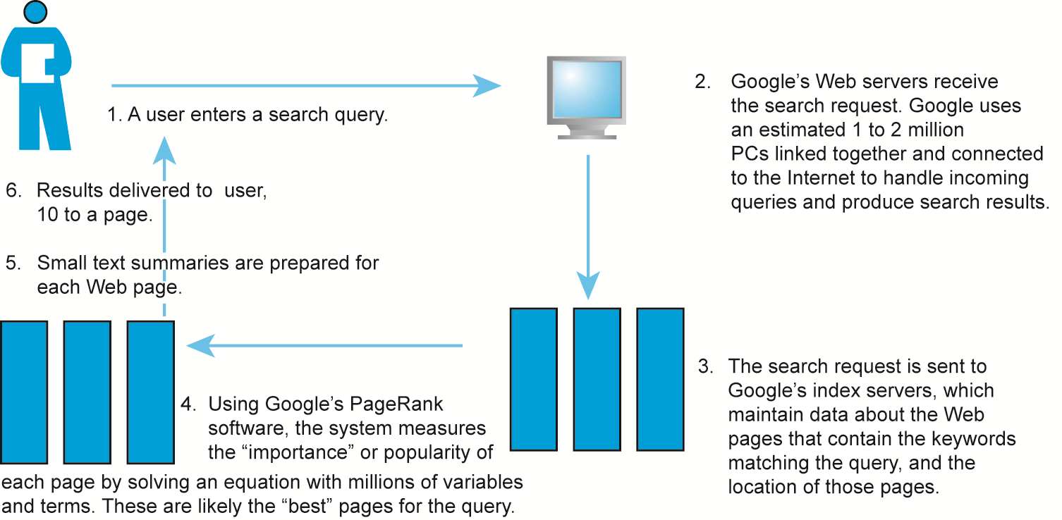
How Google Works
Figure 3.20, Page 161
Copyright © 2014 Pearson Education, Inc. Publishing as Prentice Hall
Slide 3-<number>

Slide 40
Online Forums and Chat
Online forum
  Also known as a message board, bulletin board, discussion board, discussion group, board, or forum
  Web application that enables Internet users to communicate with one another, although not in real time
  Members visit online forum to check for new posts
Online chat
  Similar to IM, but for multiple users
  Typically, users log into chat room
Copyright © 2014 Pearson Education, Inc. Publishing as Prentice Hall
Slide 3-<number>

Slide 41
Streaming Media
Enables music, video, and other large files to be sent to users in chunks so that when received and played, file comes through uninterrupted
Allows users to begin playing media files before file is fully downloaded
Copyright © 2014 Pearson Education, Inc. Publishing as Prentice Hall
Slide 3-<number>

Slide 42
Cookies
Small text files deposited by Web site on user’s computer to store information about user, accessed when user next visits Web site
Can help personalize Web site experience
Can pose privacy threat
Copyright © 2014 Pearson Education, Inc. Publishing as Prentice Hall
Slide 3-<number>

Slide 43
Web 2.0 Features and Services
Online Social Networks
  Services that support communication among networks of friends, peers
Blogs
  Personal Web page of chronological entries
Really Simple Syndication (RSS)
  Program that allows users to have digital content automatically sent to their computers over the Internet
Copyright © 2014 Pearson Education, Inc. Publishing as Prentice Hall
Slide 3-<number>

Slide 44
Web 2.0 Features and Services
Podcasting
  Audio presentation stored as an audio file and available for download from Web
Wikis
  Allows user to easily add and edit content on Web page
Music and video services
  Online video viewing
  Digital video on demand
Copyright © 2014 Pearson Education, Inc. Publishing as Prentice Hall
Slide 3-<number>

Slide 45
Web 2.0 Features and Services
Internet telephony (VoIP)
  Voice over Internet Protocol (VoIP) uses Internet to transmit voice communication
Video conferencing, video chatting, and telepresence
Online software and Web services
  Web apps, widgets, and gadgets
Copyright © 2014 Pearson Education, Inc. Publishing as Prentice Hall
Slide 3-<number>

Slide 46
Intelligent Personal Assistants
Software that interacts with the user through voice commands
Features
  Natural language; conversational interface
  Situational awareness
  Interpret voice commands to interact with various Web services
Examples: Siri, Google Now
Copyright © 2014 Pearson Education, Inc. Publishing as Prentice Hall
Slide 3-<number>

Slide 47
Mobile Apps
Use of mobile apps has exploded
  More than 60% of online shoppers are mobile shoppers as well
Increased use/purchasing from tablets
Platforms
  iPhone/iPad (iOS), Android, Blackberry
App marketplaces
  Google Play, Apple’s App Store, RIM’s App World, Windows Phone Marketplace
Copyright © 2014 Pearson Education, Inc. Publishing as Prentice Hall
Slide 3-<number>

